Slide 1


Embedded Workshop
Session
10

Slide 2




Slide 3
Hello!
Instructor:Basma Khaled &Fatma Foley.
Cairo University, EECE Department.

Slide 4


Content
What is SPI ?
SPI HW and SPECS
The beginning of i2c
i2c HW and SPECS
Difference between open drain and push-pull
how avr talk with spi and i2c

Slide 5

What is SPI ?

Slide 6

What is SPI ?
Serial Peripheral Interface (SPI) bus is a synchronous serial communication interface specification used for short distance communication.
operate with a single master device and with one or more slave devices.

Slide 7
HW connection

Slide 8
HW connection
MOSI
MISO
Master
SS/CS
Slave
SCLK
SCLK : Serial Clock (output from master).
MOSI : Master Output, Slave Input (output from master).
MISO : Master Input, Slave Output (output from slave).
SS : Slave Select (active low, output from master).

Slide 9
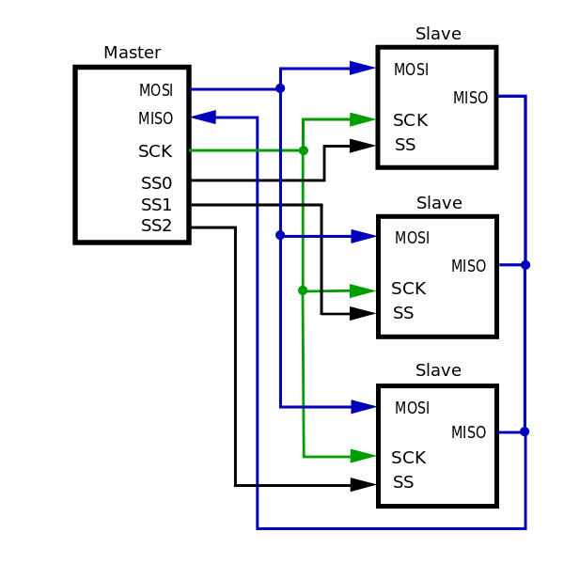
Types of network
Independent slaves
Daisy chain
MOSI
MISO
SCK
SS0
SS1
SS2
MOSI
MISO
SCK
SS
MOSI
MISO
SCK
SS
MOSI
MISO
SCK
SS

Slide 10
Way of communication

Slide 11
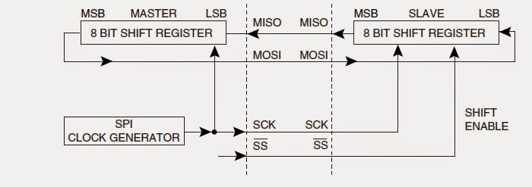
Way of communication
It happens through shift register
master swaps a bit with the slave every clock cycle.

Slide 12
SPECS

Slide 13
SPECS
full duplex ,sure!!
SMMS
Serial
Synchronous

Slide 14


Frame
It’s frameless
No start bit
No stop bit
No address
Just raw data
$∴$ throughput =100%

Slide 15
Read or Write

Slide 16
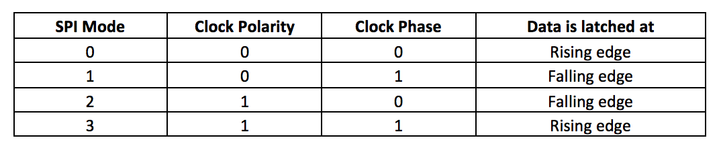
Clock polarity
Read then write or write then read ?
who first
Sample
Setup
Sample
setup

Slide 17
I2C

Slide 18
The begin of I2C ”inter integrated circuit”
Need to connect between ICS
serial communication protocol at which the devices are hooked up to the I2C bus with just two wires.
Why not SPI?
→two many wires
Why not UART?
→communication between MCs
Is it I2C or TWI ”Two wire interface”?

Slide 19
HW connection

Slide 20
HW connection
SDA: serial clock Line
SCL: serial Data line

Slide 21
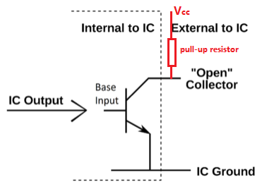
Open-drain Vs push-pull

Slide 22
What is dominant and Recessive ?
Dominant Bit: A bit that appears on the bus if any node writes it. In our system the 0 is the dominant
Recessive Bit :A bit that appears on the bus if all nodes write it. In our system the 1 is the recessive

Slide 23
SPECS

Slide 24
SPECS
Wired
Serial
MMMS
Half duplex
Synchronous
Throughput →based on frame

Slide 25
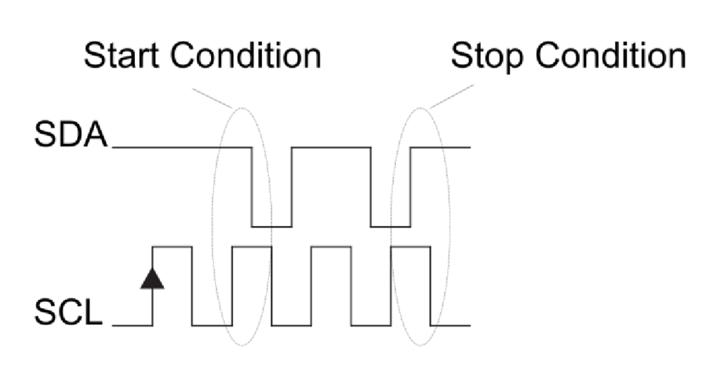
Frame
Start condition
Address packet
Data packet
stop condition
Start condition
SDA(falling) +SCL(High)
2) Stop condition
SDA(falling) +SCL(High)

Slide 26
Address packet (9 bits)
Address number (7 bits)
R/W bit
1 bit ack
Data packet
Data(8bits)
Ack
Start condition
Address no
W/R
ACK
Data packet
stop condition
Start condition
Address no
W/R
ACK
Data
ACK
stop condition

Slide 27
Way of communication (Two scenarios)
Master writes on slave
Master read from slave

Slide 28
SPI advanced definitions
Multi Master Arbitration
Repeated start
Clock stretching
Bus starvation

Slide 29


Slide 30
Task: Use I2C protocol to interface the LCD
Using I2C communication:
Interface 16x2 LCD via I2C module
Initialize I2C peripheral
Send command and data to LCD

Slide 31
Thank You!
Any questions?

